Slide 1
Butternut HF9V
G3TZO

Slide 2
History (HF6V)
Butternut HF6V for 20 plus years
Specified for 75/80, 40, 30, 20, 15, 10m
Height 26ft
Rated 1.5KW
VSWR 1.5 or less all bands
Performed well all bands with ATU (80, 40,30,17,15,12,10m)
Physically deteriorated with age
Time to update

Slide 3
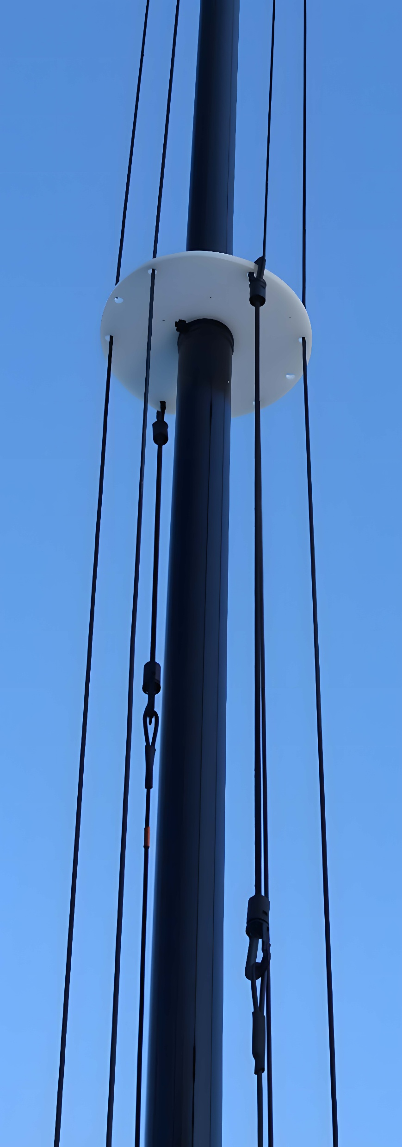
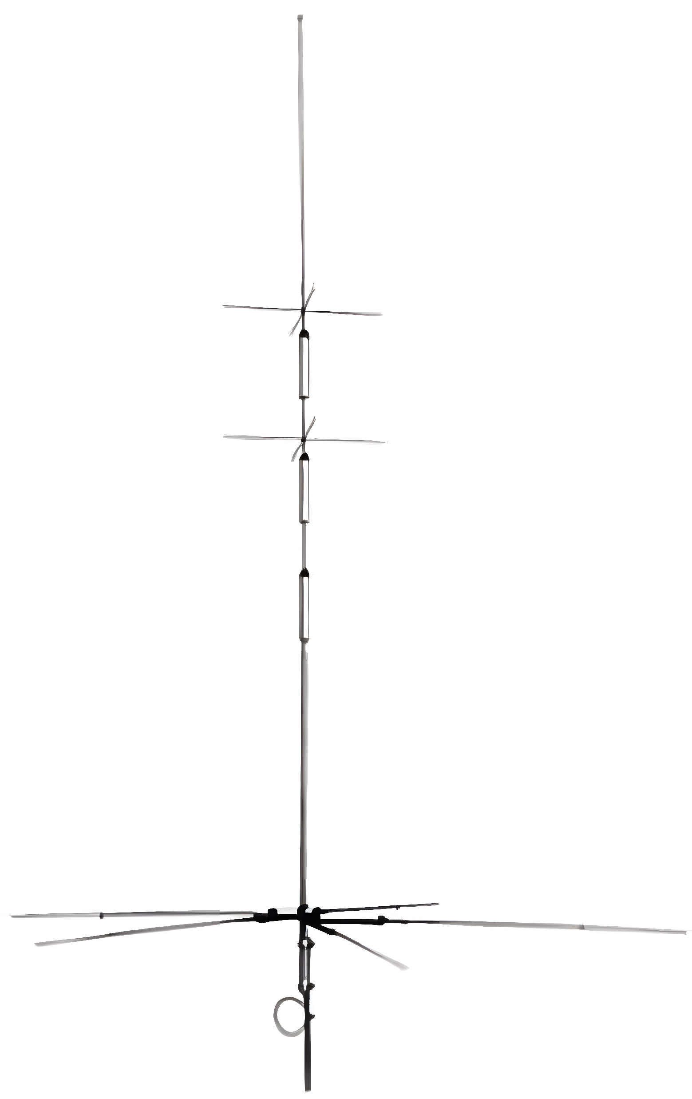
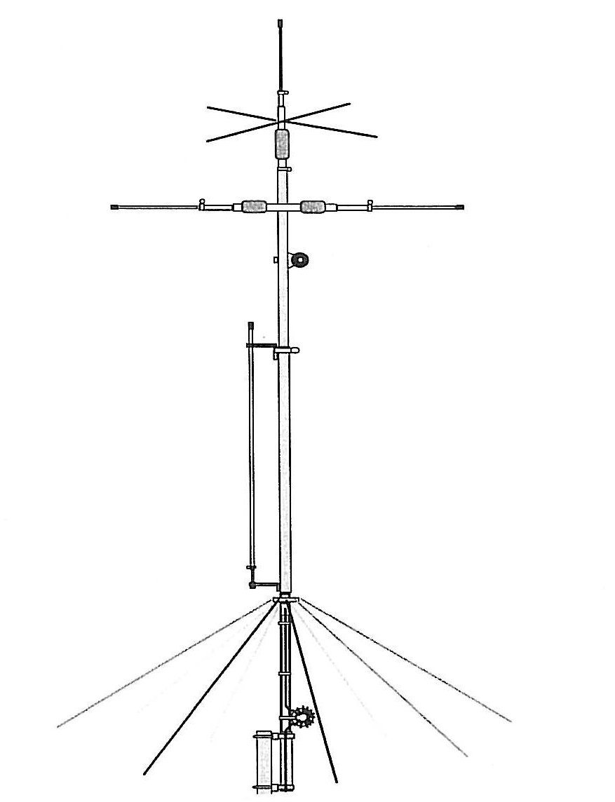
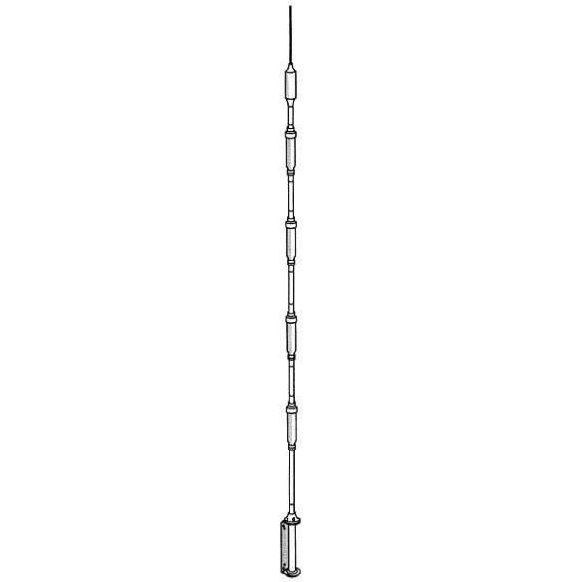
Choices
Hustler 6BTV
Diamond CP6
Cushcraft MA6VA
DX Commander

Slide 4
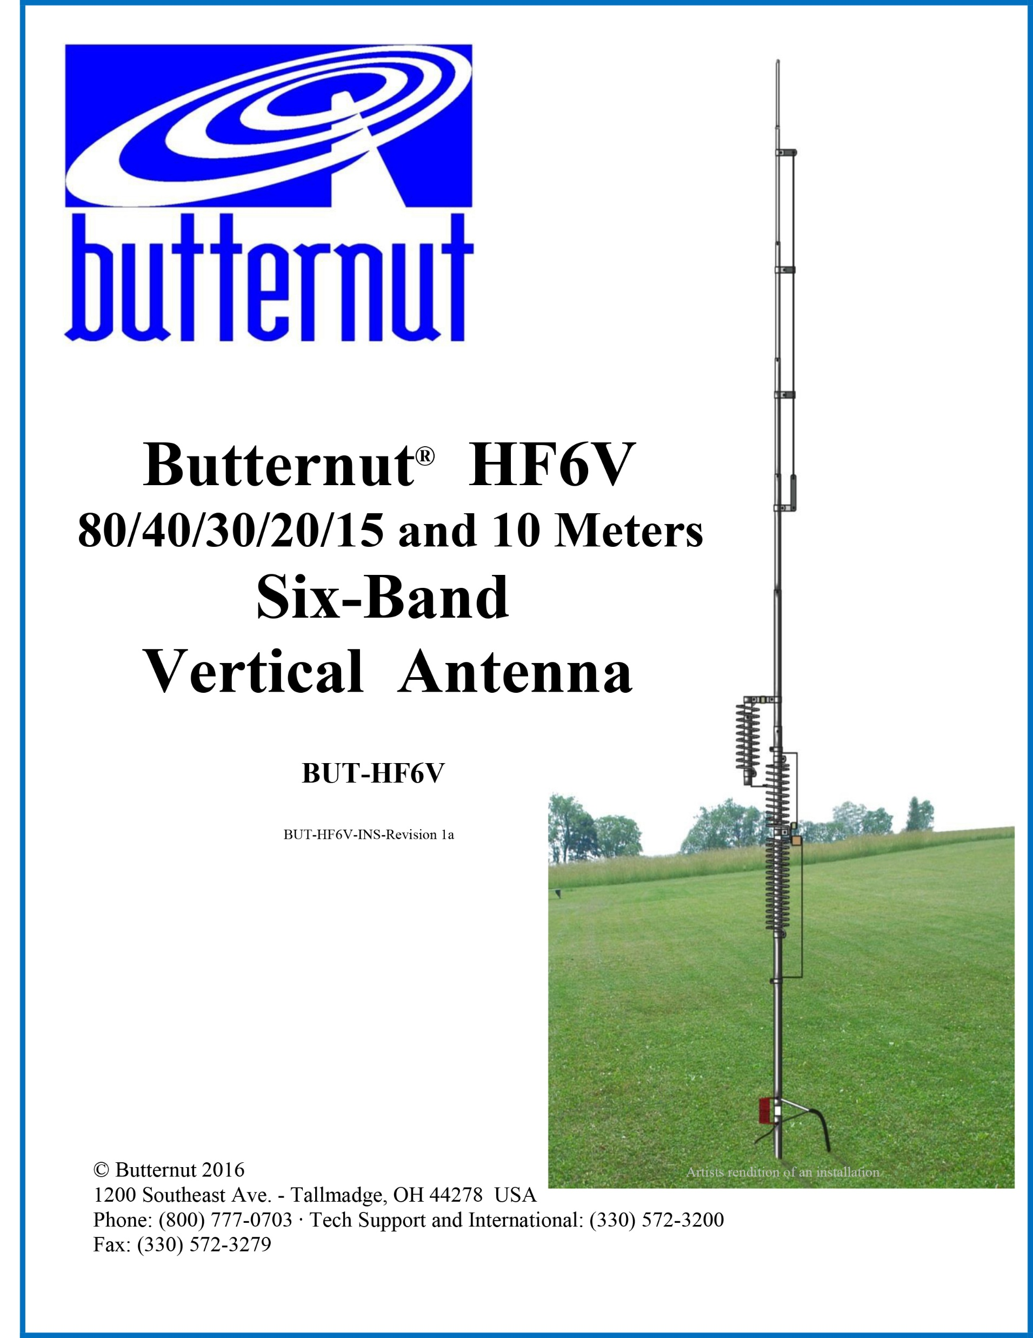
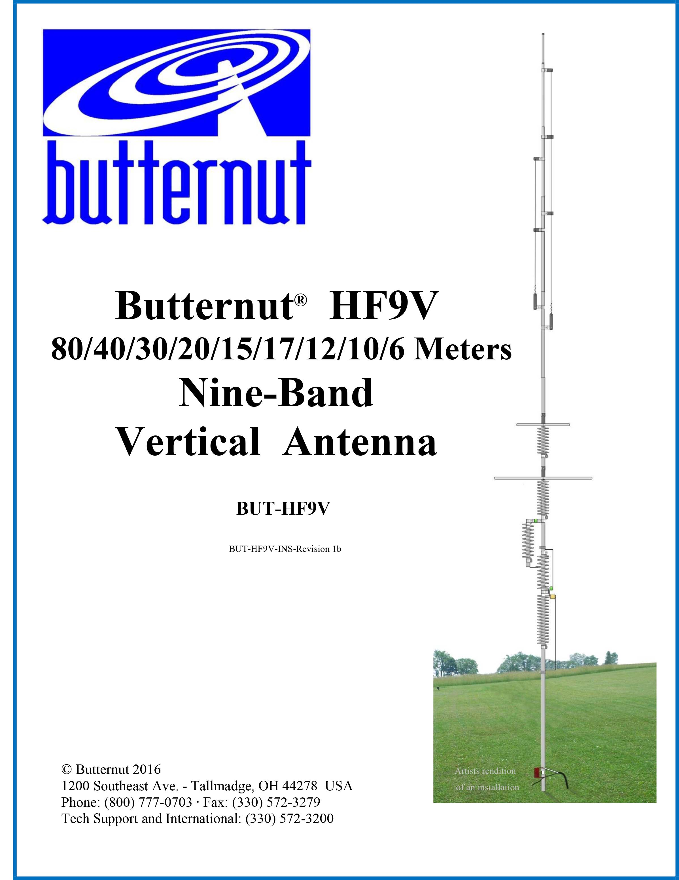
Butternut Comparison

Slide 5
HF9V Features
80m to 6m including all WARC Bands
26 feet high
Handles 1.5 KW
1.5 to 2.5 VSWR or less on all bands
Bandwidth for max VSWR of 2.1 on all bands except 80m, 40m & 6m is the entire band
Bandwidth of 150 kHz on 40m with max 2.5 VSWR
Bandwidth of 30 kHz on 80m with max 2.5 VSWR
Requires radial system (12 x 30 ft)

Slide 6
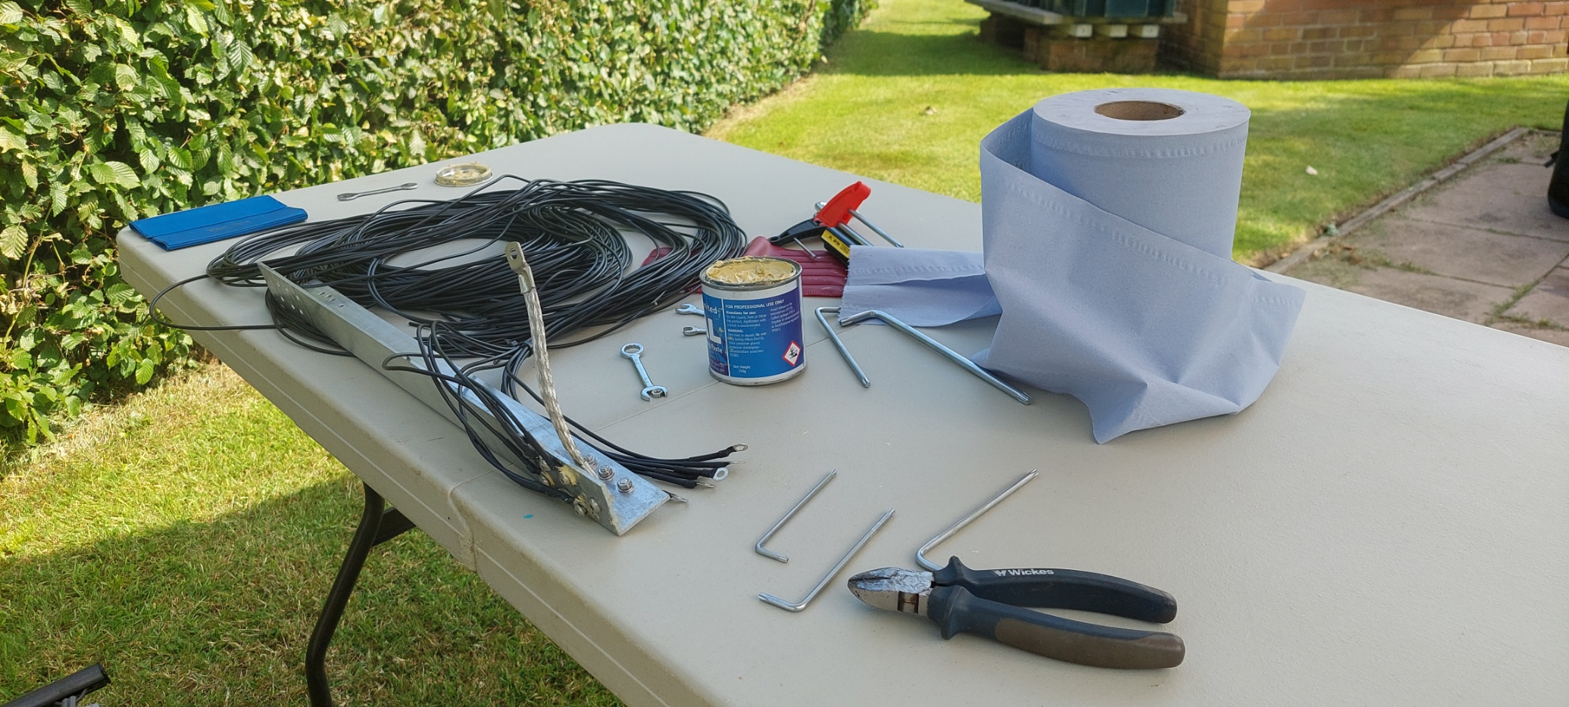
Installation

Slide 7
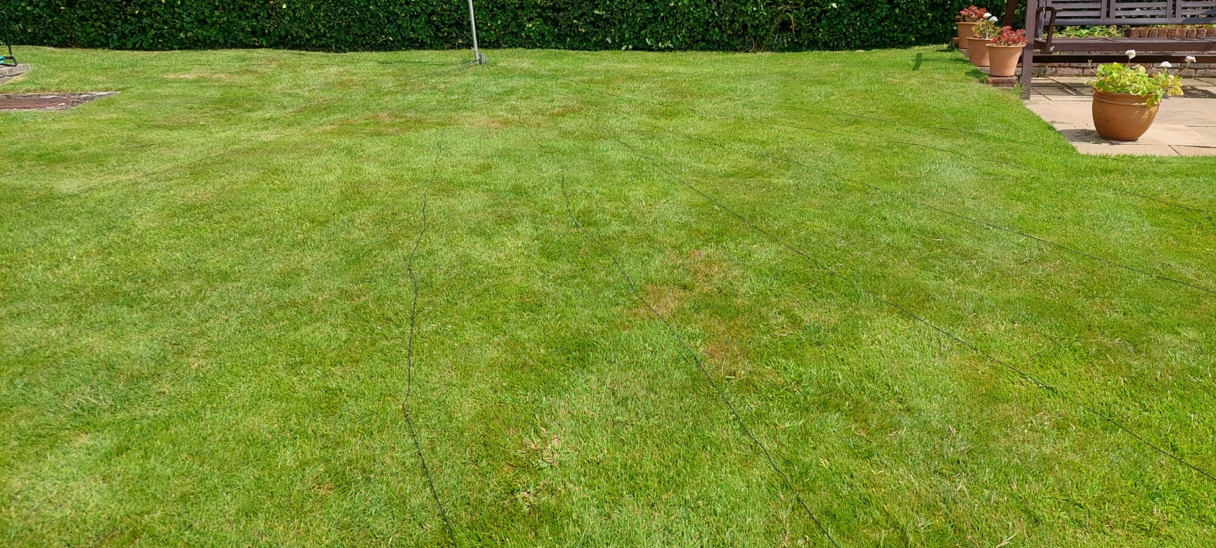
Laying out the radial system (12 x 30ft)

Slide 8
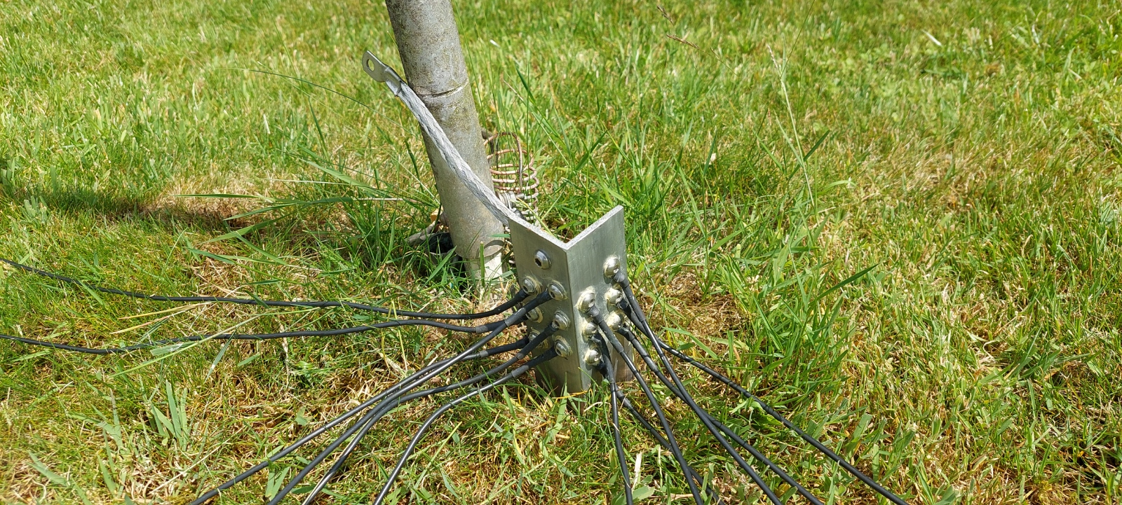
Terminating Radials

Slide 9
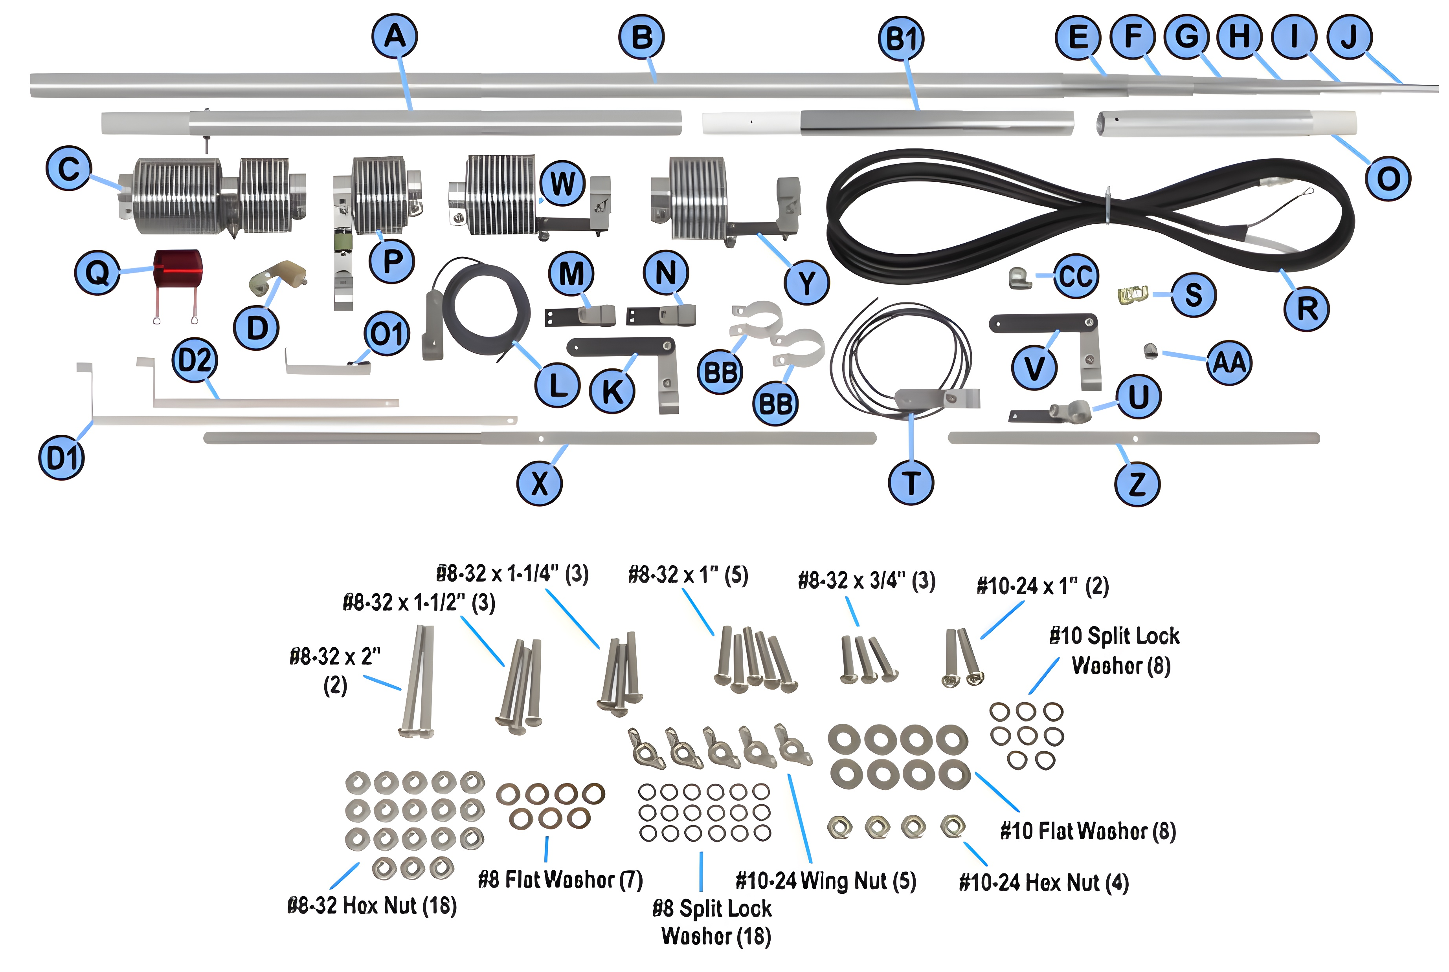

Slide 10
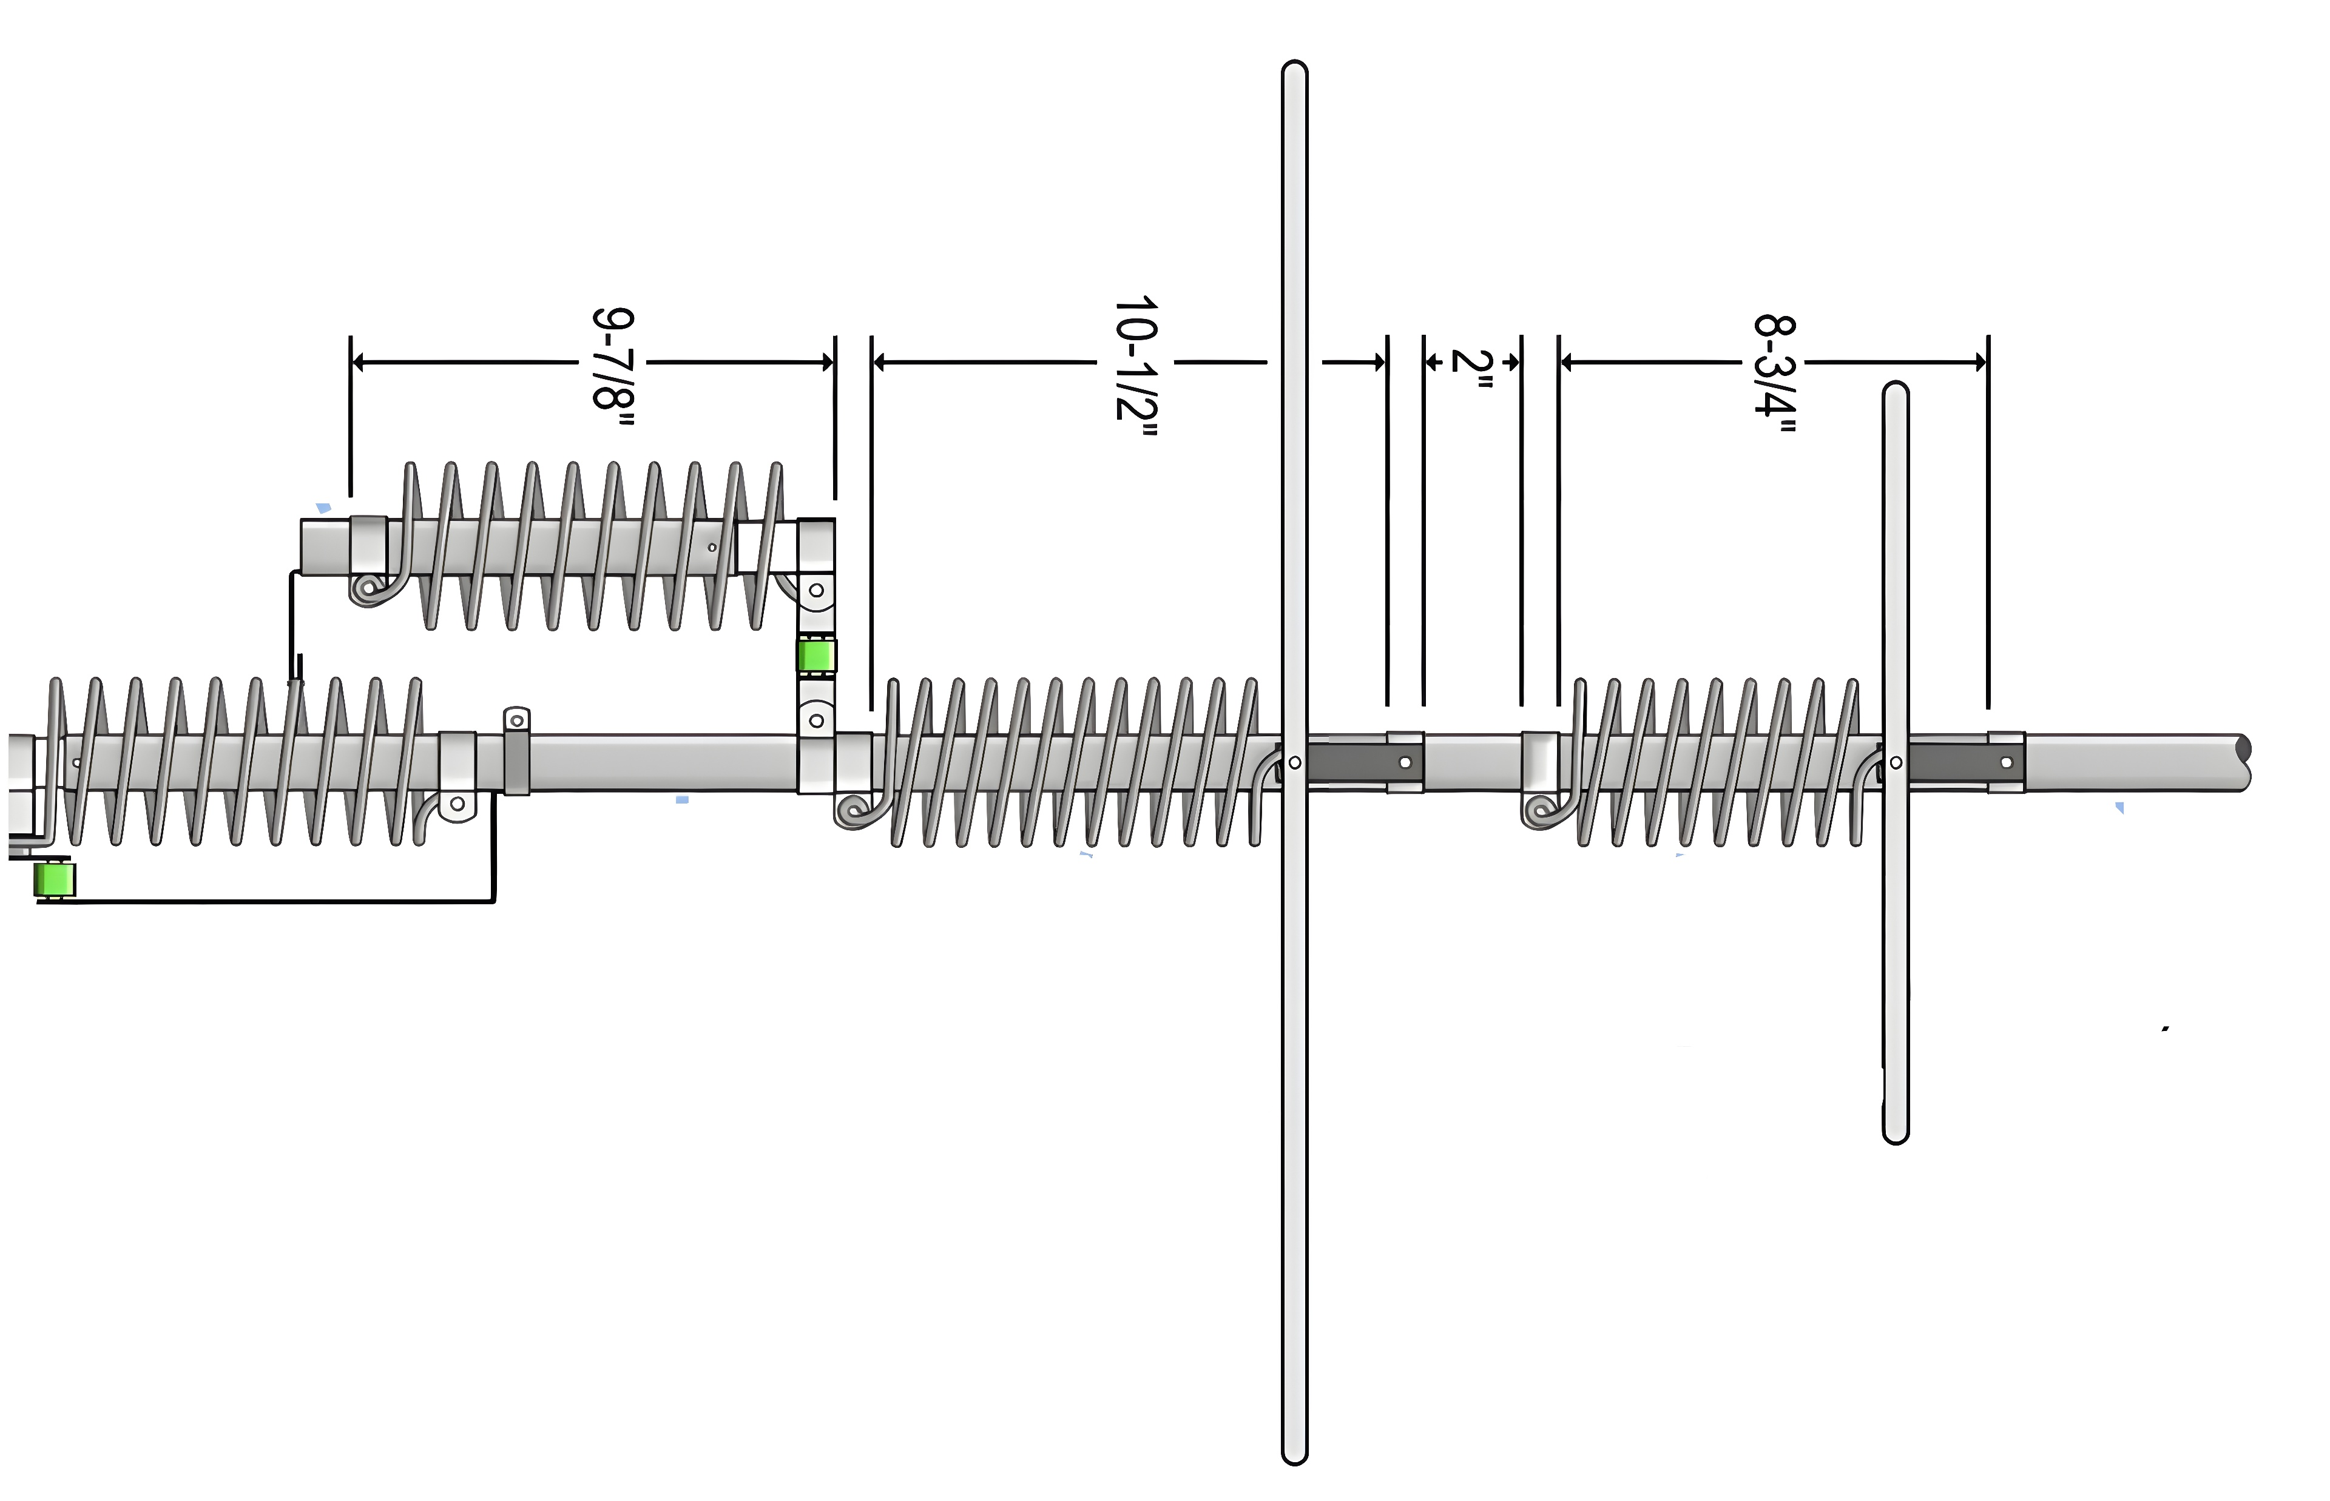

Slide 11
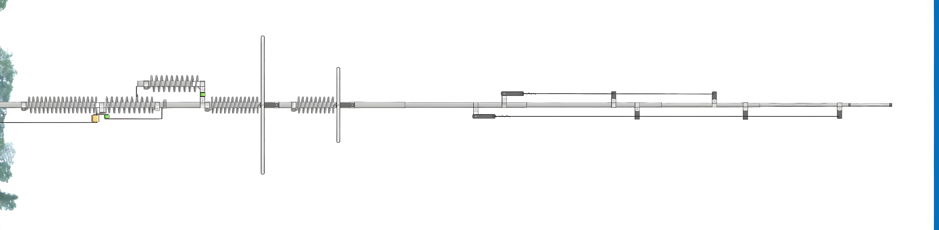
17m capacitance hat
6m ¼ wavelength short circuited transmission line
30m
80m
12m
40m
17m
12m capacitance hat
15m ¼ wavelength stub decoupler

Slide 12
Theory of operation 80m
The first L/C circuit generates enough reactance to bring the whole HF9V to resonance on 80 meters allowing it to act as an electrical 1/4-wavelength radiator. It also generates enough capacitive reactance to produce another discrete resonance at about 11 MHz

Slide 13
Theory of operation 40m
The second, 40 meter L/C circuit generates enough reactance to resonate the whole HF9V allowing it to act as a 1/4-wavelength radiator. In order to minimize conductor and I²R losses on 80 and 40 meters, where the antenna is physically shorter than a 1/4-wavelength and thus operates with lower values of radiation resistance, large-diameter self-supporting inductors and low-loss ceramic capacitors are employed.

Slide 14
Theory of Operation 30m
Where the height of the HF9V is slightly greater than a 1/4-wavelength on 30 meters, an L/C series tuned circuit taps onto the 40 meter coil for the extra inductance to pull the earlier 11 MHz secondary resonance down to 10 MHz.
At the same time, a portion of the 40 meter coil is shorted out which allows the circuit to resonate on 30 meters The addition of this circuit also produces additional resonances at 14 MHz and 28 MHz.

Slide 15
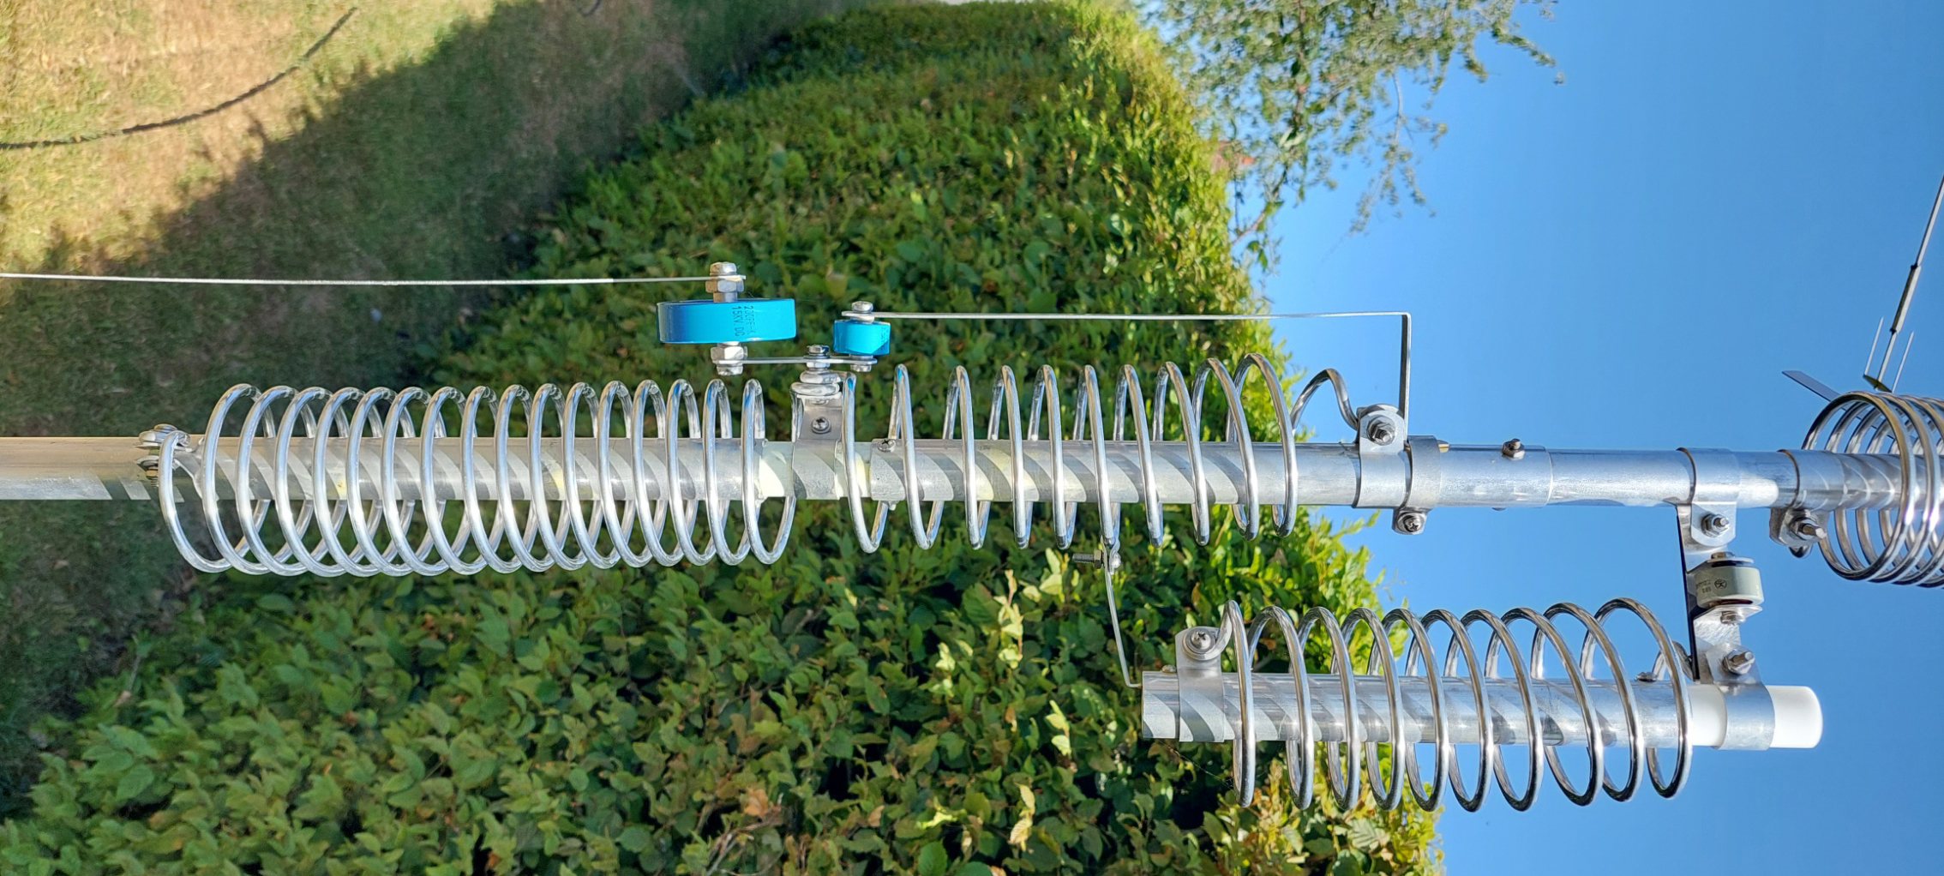

Slide 16
Theory of operation 20m
On 20 meters the entire radiator operates as a 3/8-wavelength vertical with much higher radiation resistance and VSWR bandwidth than conventional or trapped antennas having a physical height of 1/4-wavelength or less.
Because the 20 meter radiation resistance will be several times greater than that of conventional vertical antennas, an electrical 1/4-wavelength section of 75 ohm coax is used as a geometric mean transformer to match the approximate 100 ohms of feedpoint impedance on that band to a 50 ohm main transmission line of any convenient length.

Slide 17
Matching by mismatch?
Imagine two curves with exactly dissimilar shapes such as a LPF and a HPF.
Connect each circuit in series and the resulting curve will be flat (but with increased attenuation)

Slide 18
Theory of operation 15m
The HF9V operates as a slightly extended 1/4-wavelength radiator on 15 meters, a 1/4-wavelength stub decoupler providing practically lossless isolation of the upper half of the antenna on that band.

Slide 19
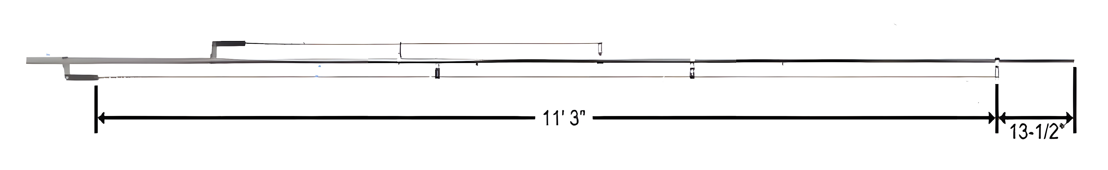
6m ¼ Wave Transmission Line
15m 1/4 wavelength stub decoupler

Slide 20
Theory of operation 17m & 12m
On 17 and 12 meters the coils act as packets of reactance which allow the entire radiator to operate as a 1/2-wavelength or 5/8-wavelength vertical. Capacitance for these circuits comes from what exists between the windings, the radiator and the capacitance hats.

Slide 21
Theory of operation 10m
On 10 meters the HF9V becomes a 3/4-wavelength radiator with considerably greater radiation resistance and efficiency than ¼ wavelength trapped types.

Slide 22
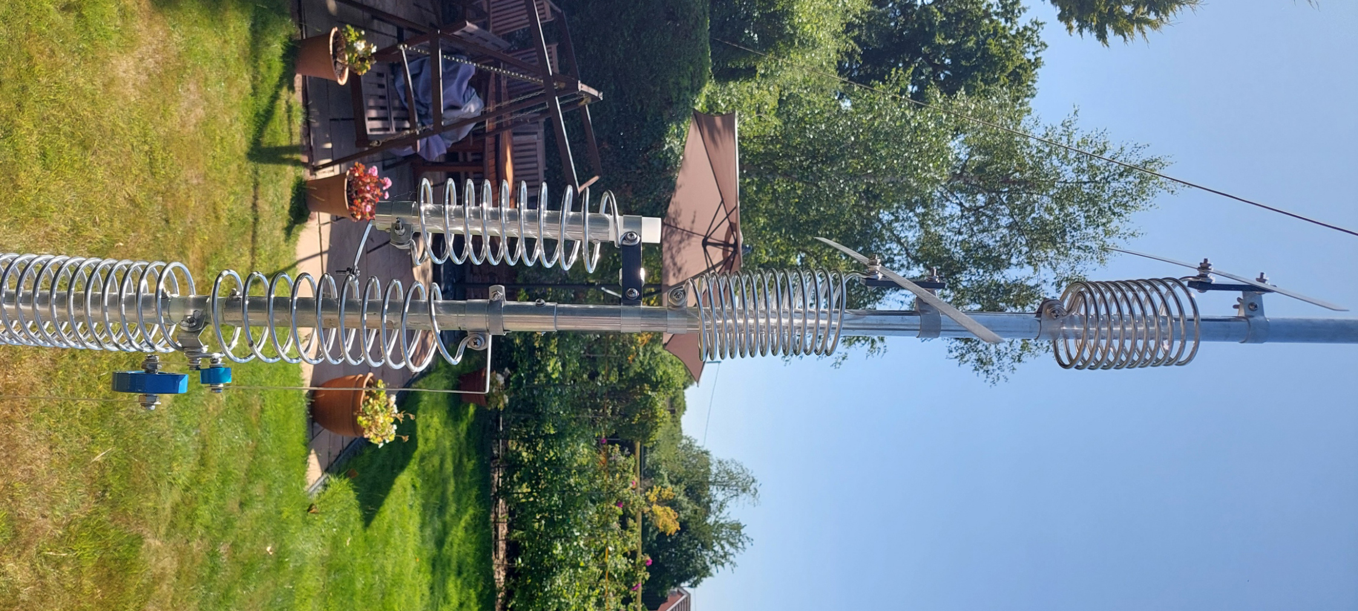

Slide 23
Theory of operation 6m
On 6 meters the vertical wire, together with the adjacent section of antenna, form a short-circuited 1/4-wavelength transmission line which cancels current flow.
At the lower, open end of the 1/4- wavelength section a very high impedance is created the effectively divorces the upper part of the antenna leaving the lower section to radiate as a 3/4-wavelength vertical.

Slide 24
6m Vertical Wire
15m 1/4 wavelength stub decoupler

Slide 25
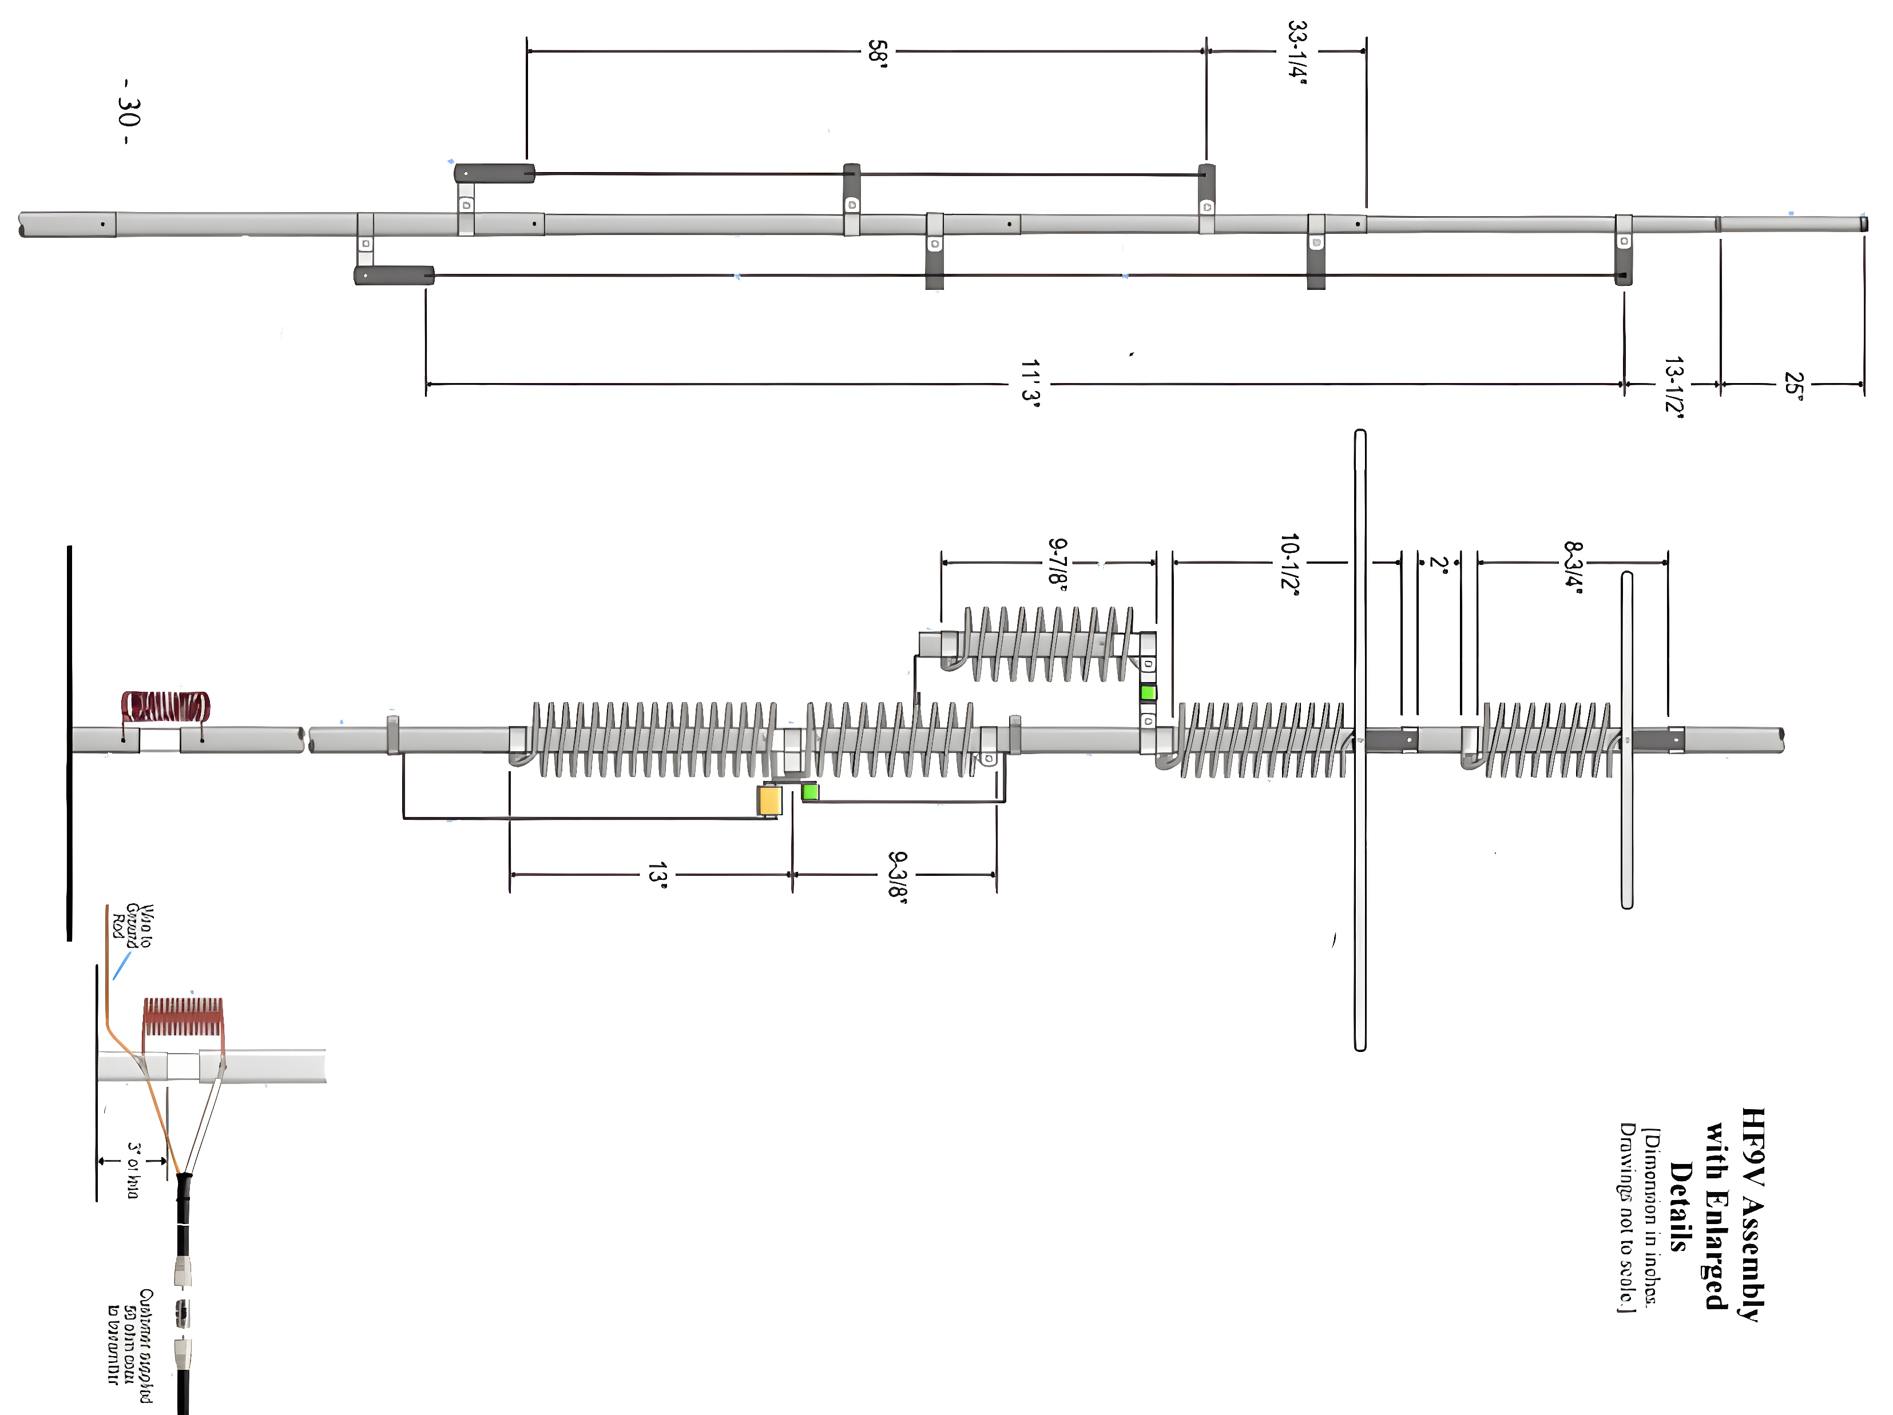

Slide 26
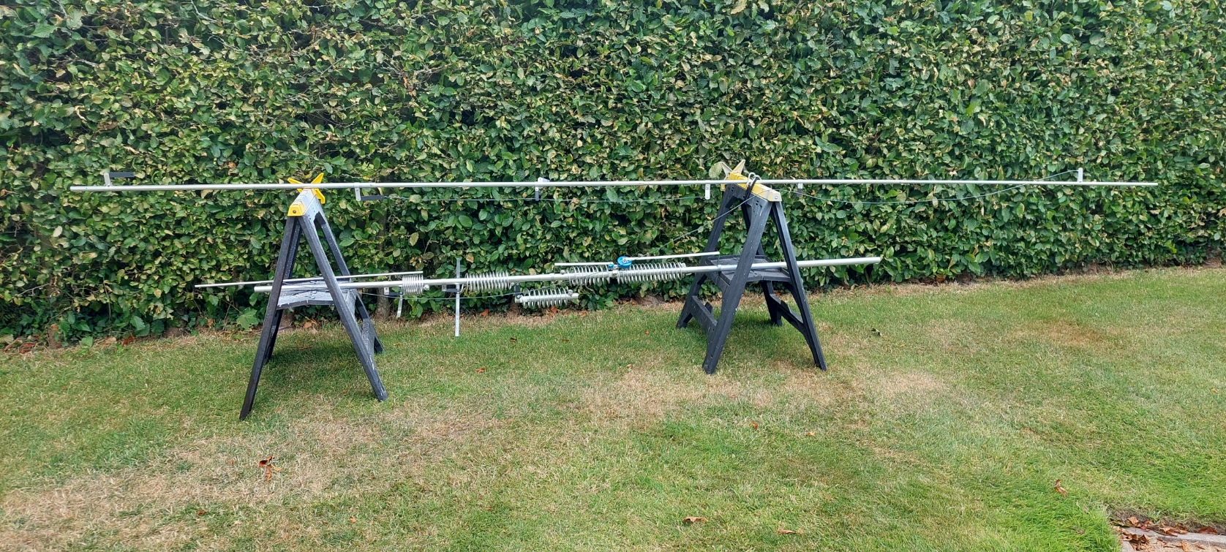

Slide 27
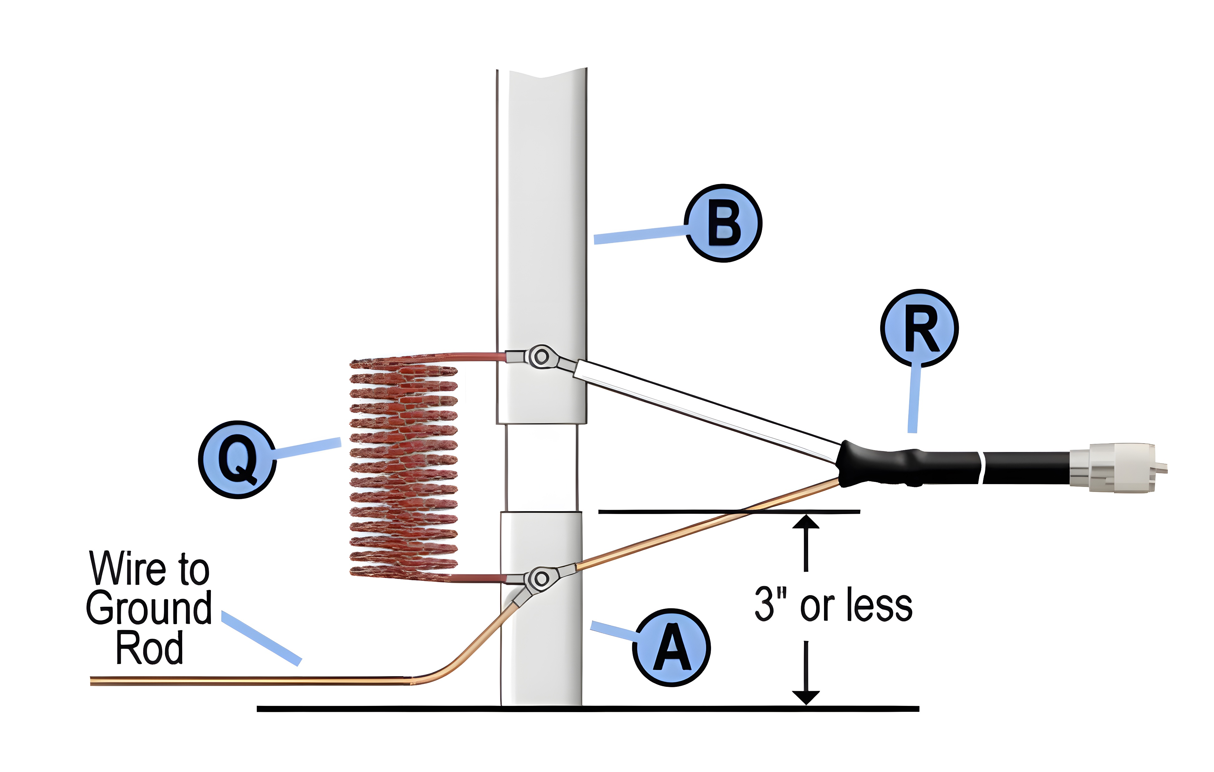

Slide 28
The base matching coil at the bottom of the antenna may be adjusted for even lower VSWR.
If earth losses are moderate to high a good match may be possible if the base matching coil is left fully compressed;
If earth losses are low (as with an extensive radial system) the base matching coil may have to be stretched to twice its compressed length or more for a good match.

Slide 29
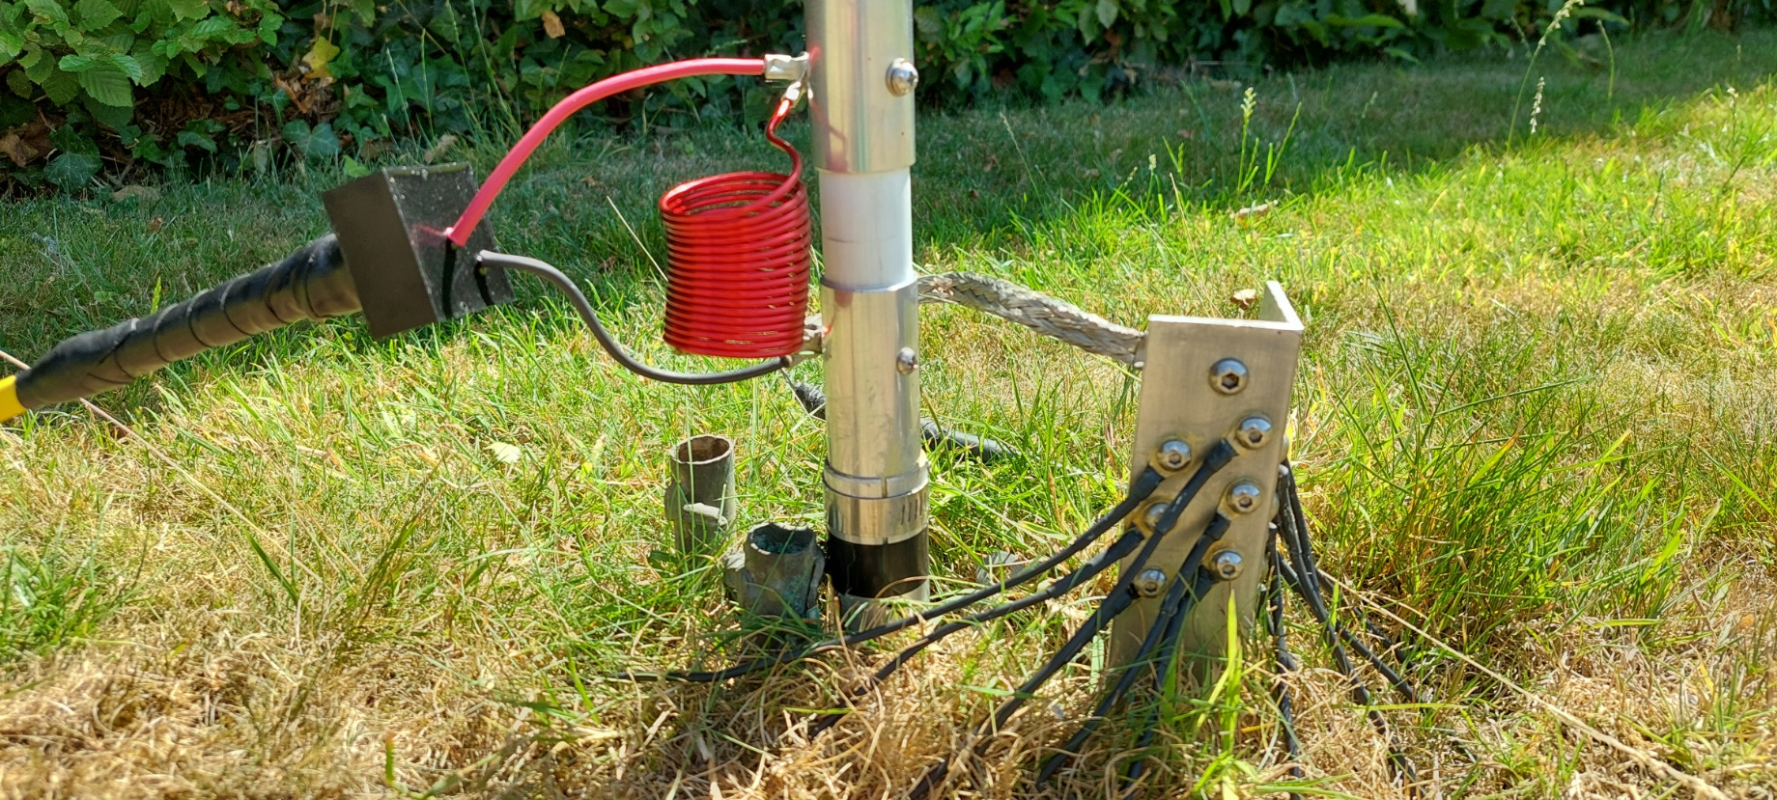

Slide 30
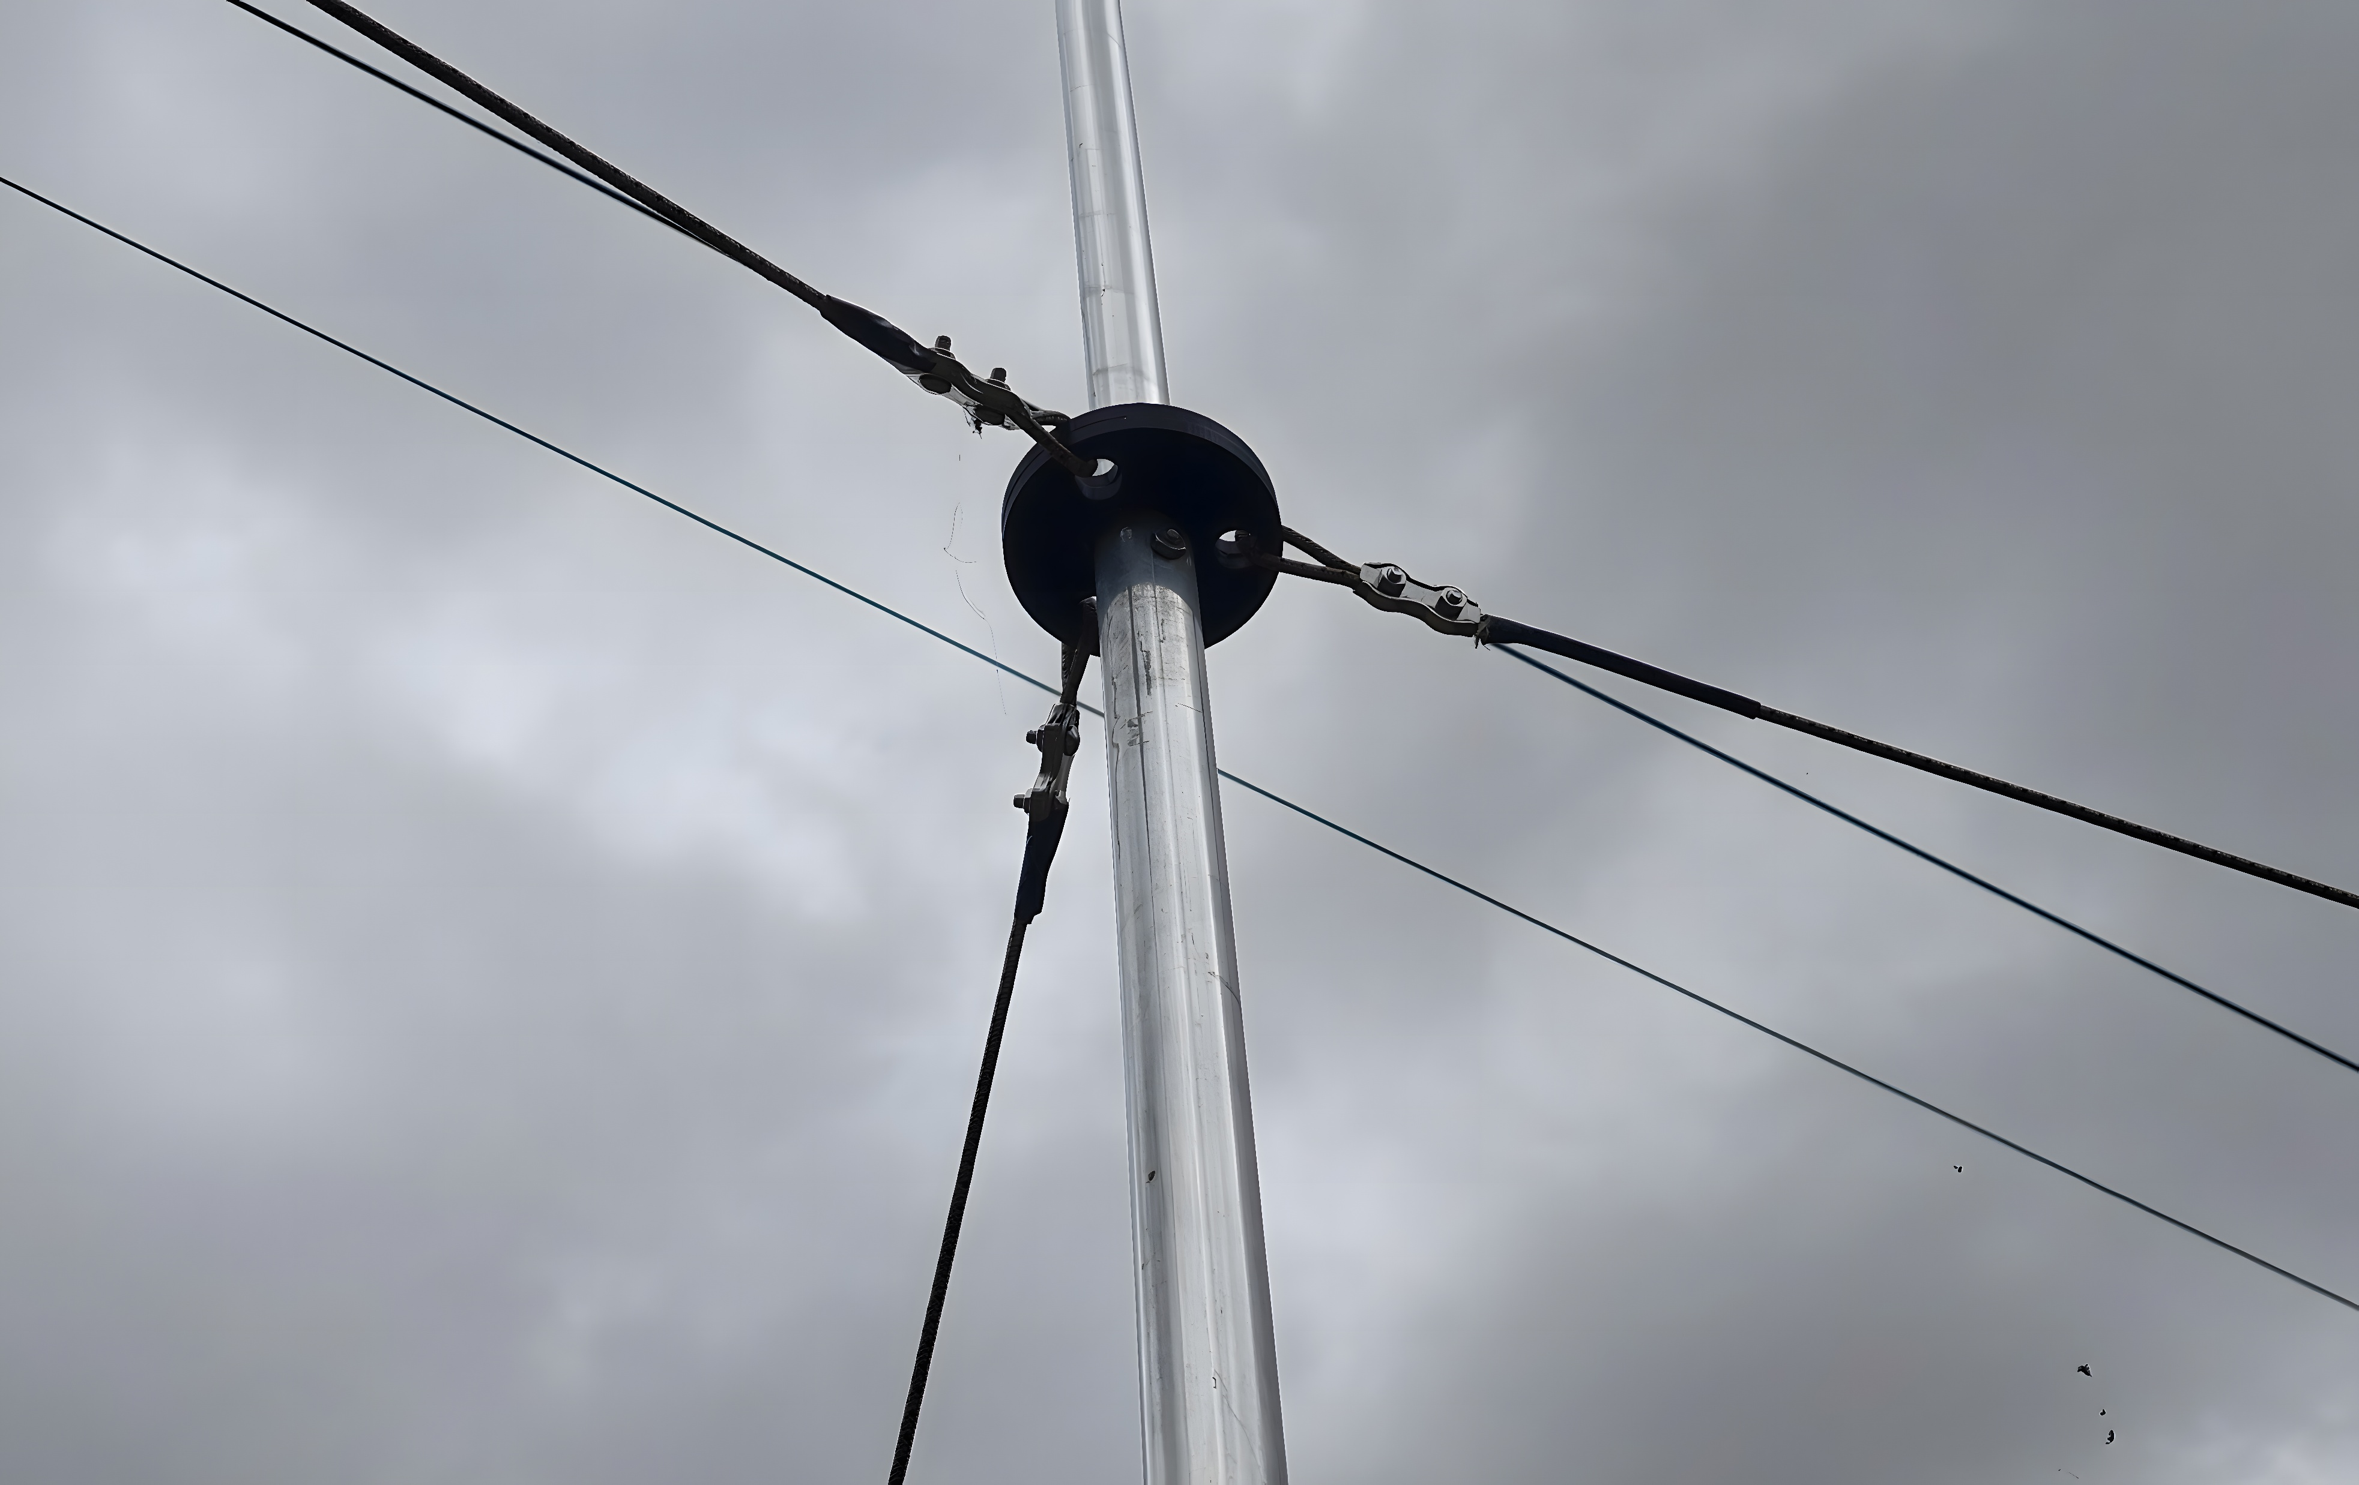
Guy fixing on HF9V
Using G7REV patented design

Slide 31
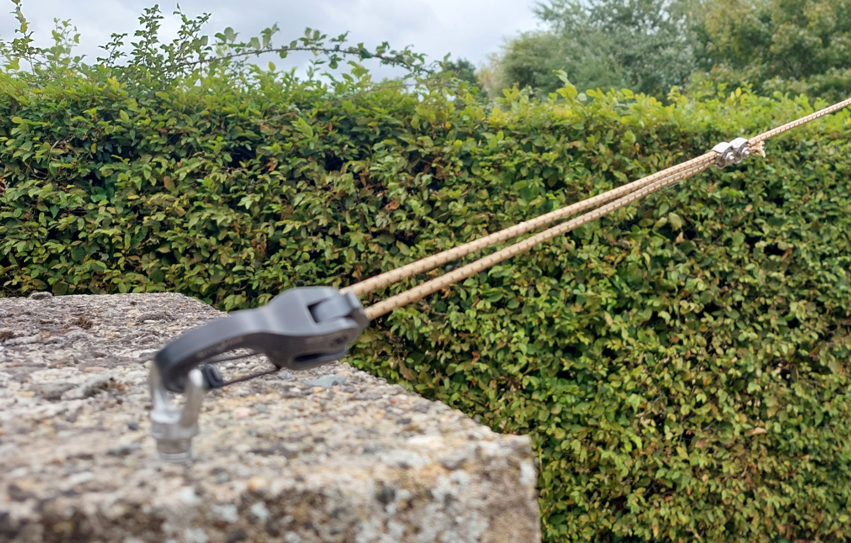
Guy fixing in concrete with Tensioning Carabiner and Duplex Guy Rope Clamp

Slide 32
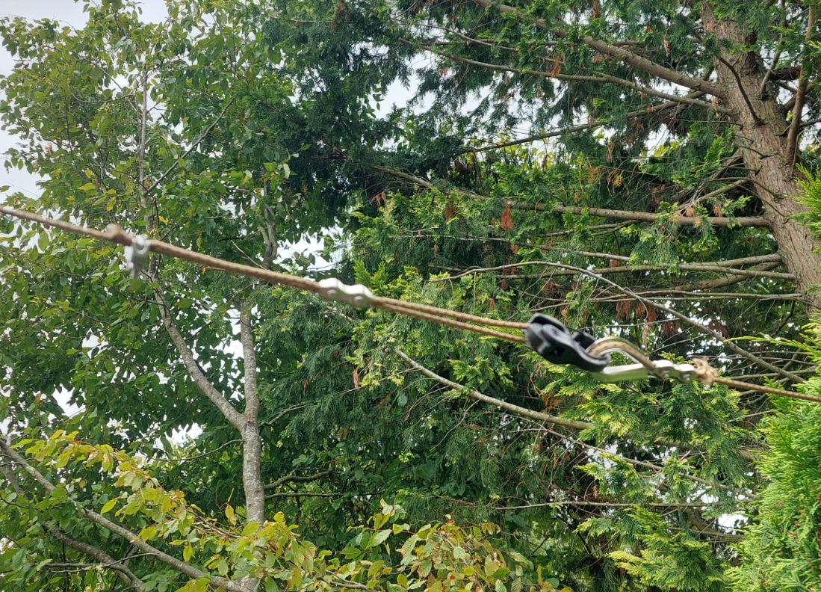
Guy rope fixing in hedge with Thimble, Tensioning Carabiner, Duplex Clamp and U bolt clamp

Slide 33
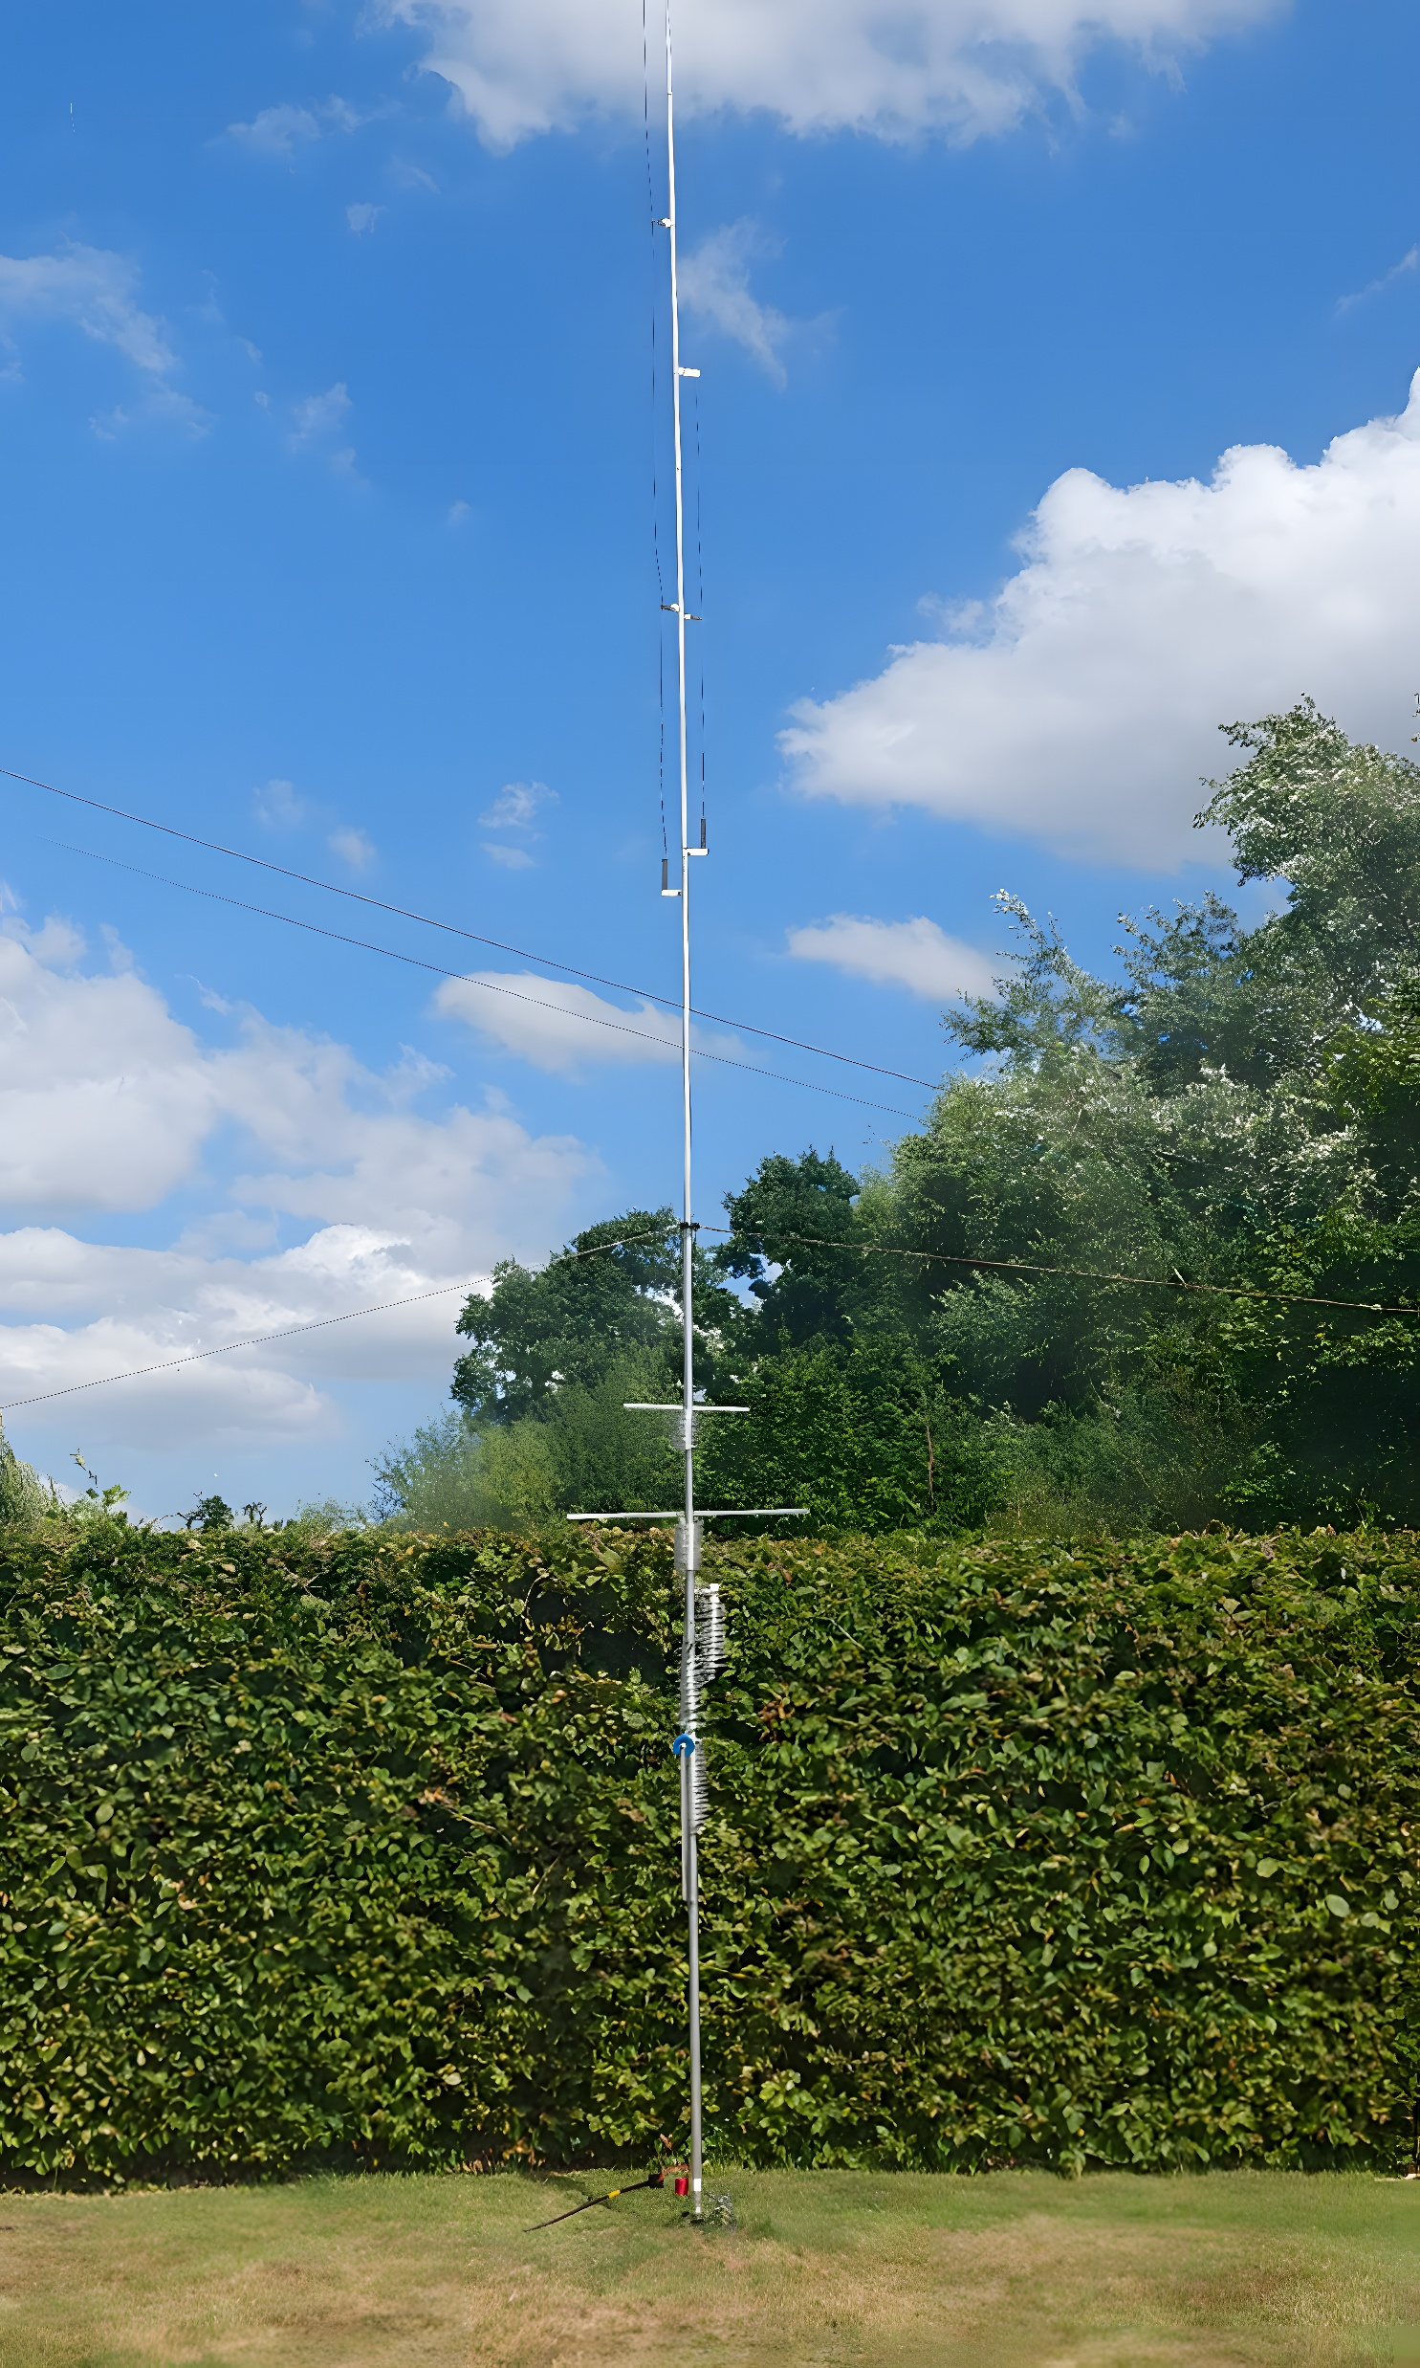
The finished antenna

Slide 34
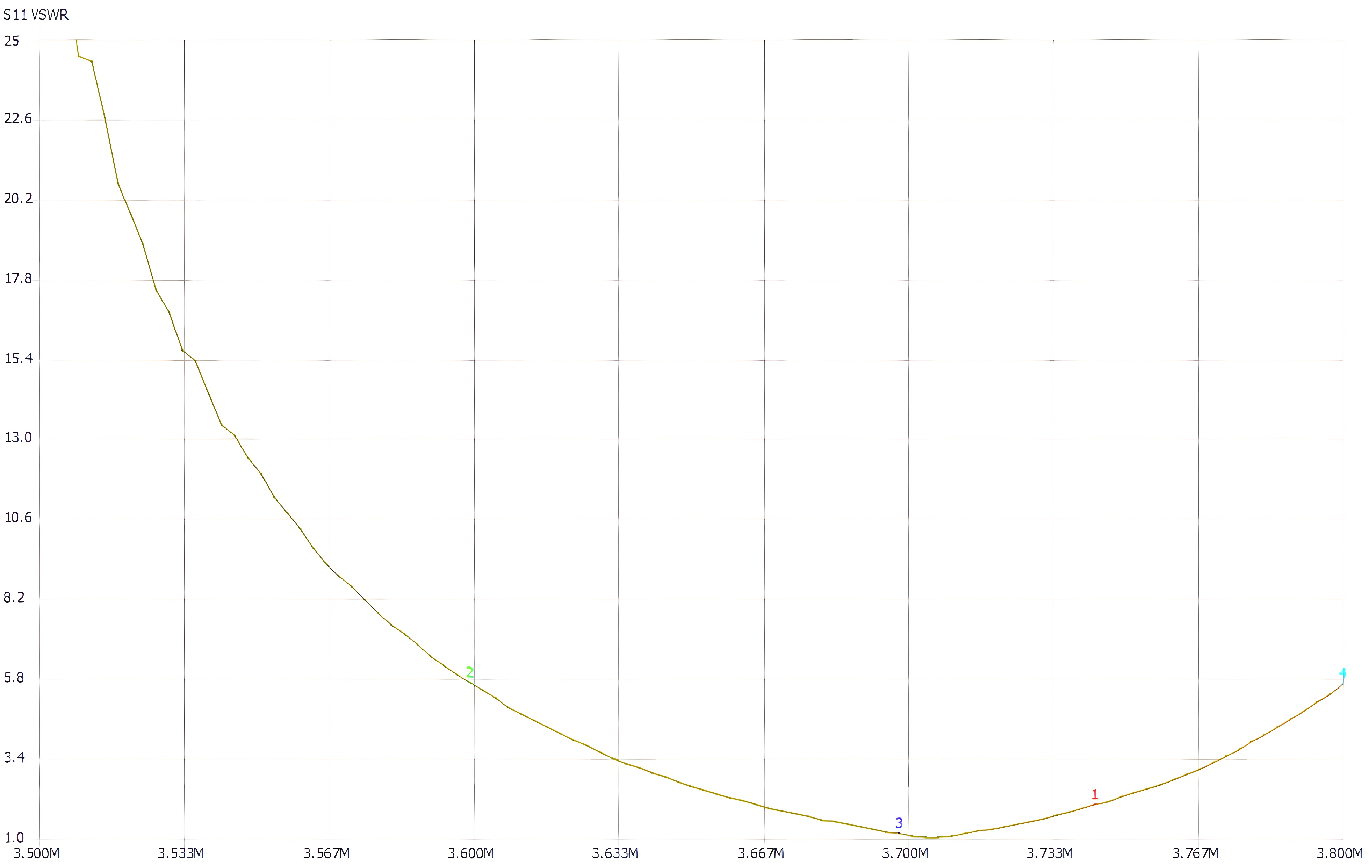
80m plot

Slide 35
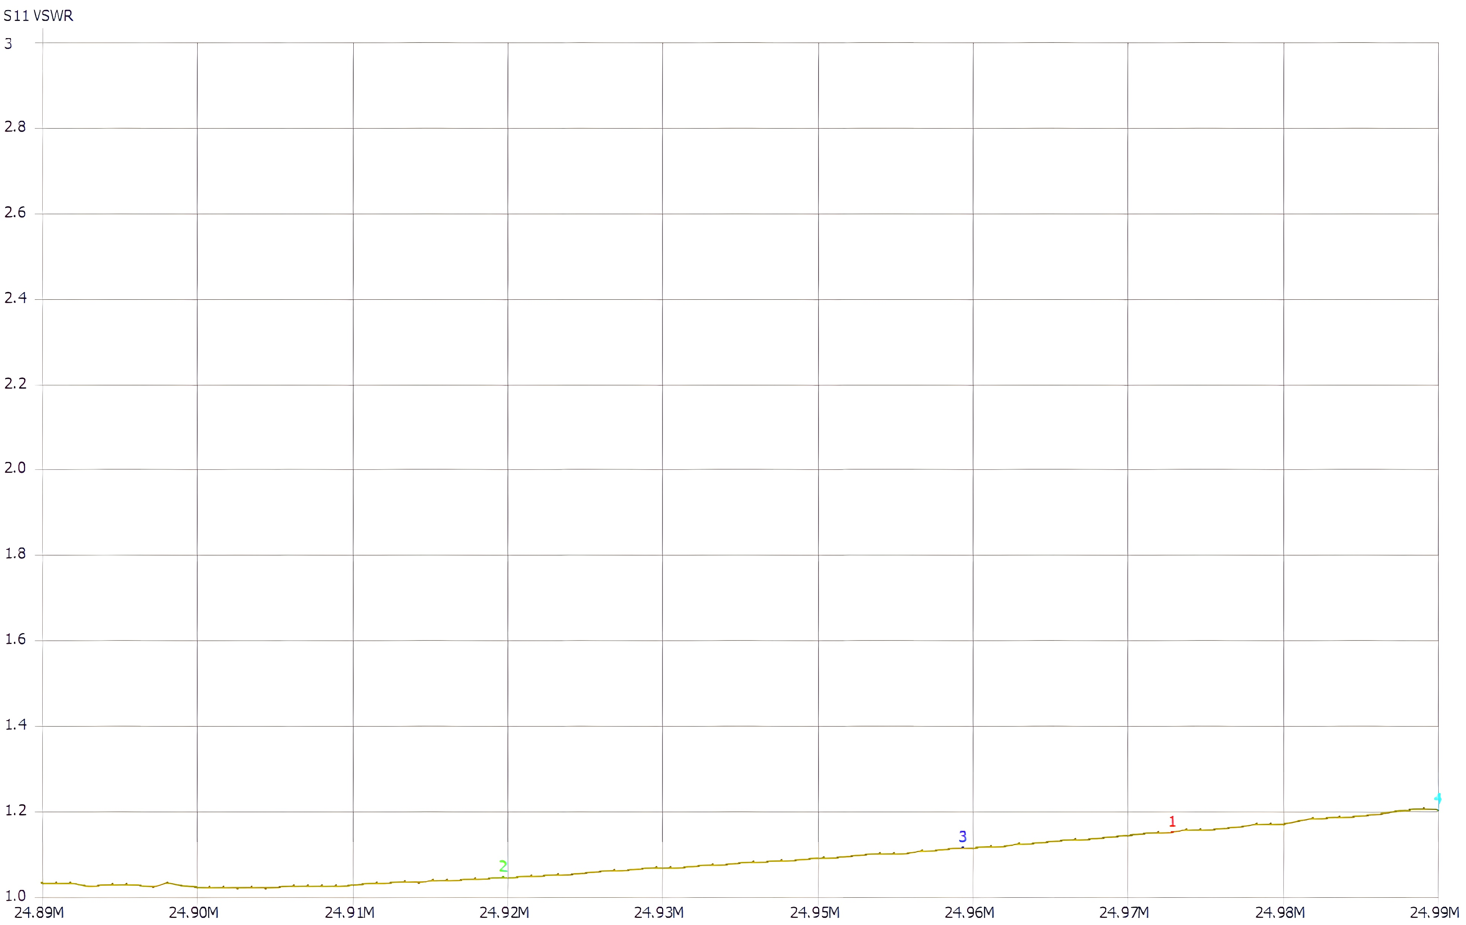
12m Plot

Slide 36
Thanks to Ian M1ICl and Chris G0PJX for assistance in erection and testing

